Slide 1


CE141: COMPUTER CONCEPTS & PROGRAMMING
July – November 2018
Chapter – 4
Introduction to ‘C’ language
Devang Patel Institute of Advance Technology And Research

Slide 2


Objectives
To get understanding of evolution of ‘C’ Language
To develop programming skills using the fundamentals and basics of C language
To impart the knowledge about basic structure which is the backbone of programming
To understand the significance of ‘C’ language
To teach the basics of preprocessors available with C compiler
To Develop an understanding of the compilation process
Chapter – 4 : Introduction to ‘C’ Language

Slide 3
1-1 History of C
C is a programming language which born at “AT & T’s Bell Laboratory” of USA in 1972.
C was written by Dennis Ritchie, that is why he is also called as father of c programming language.
C language was created for a specific purpose i.e designing the UNIX operating system (which is currently base of many UNIX based OS).
From the beginning, C was intended to be useful to allow busy programmers to get things done because C is such a powerful and dominant language
Chapter – 4 : Introduction to ‘C’ Language

Slide 4
1-1 History of C Continued…
Why Name “C” was given to Language ?
Many of C’s principles and ideas were derived from the earlier language B. (Ken Thompson was the developer of B Language.)
BCPL and CPL are the earlier ancestors of B Language , CPL is combined Programming Language. In 1967, BCPL Language ( Basic CPL ) was created as a scaled down version of CPL.
As many of the features were derived from “B” Language that is why it was named as “C”.
After 7-8 years C++ came into existence which was first example of object oriented programming .
Chapter – 4 : Introduction to ‘C’ Language

Slide 5
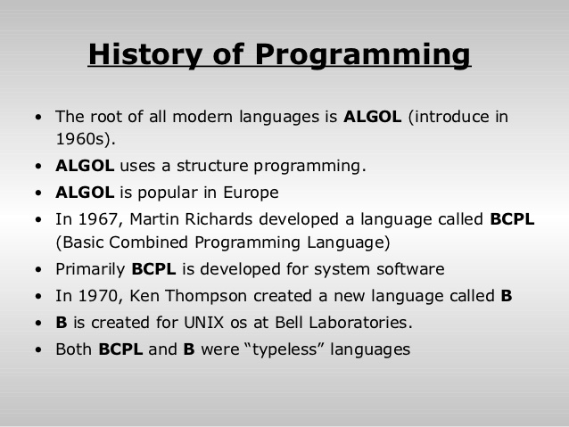
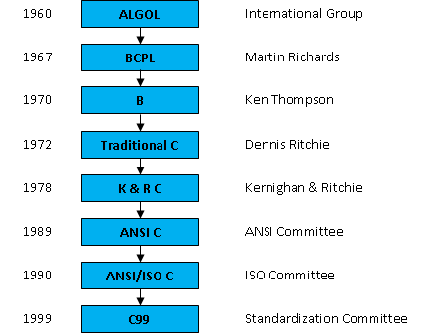
1-1 History of C Continued…
Chapter – 4 : Introduction to ‘C’ Language

Slide 6
1-2 Characteristics of C
Simple and Clear----C has richest collection of data types(int,float,char), operators(symbolic representation) and inbuilt functions.
2. Stuctured Approach----C provide the fundamental control flow constructions required for well structured program like statement grouping, decision making(if-else),switch-case, break etc.
Portable----C has the characteristics of portability .Portable means computer independent. The programs made in C on one computer can be run on different computers by not changing anything.
4. Case Sensitive----Case Sensitive means that almost everything in C program is written in small case.
Chapter – 4 : Introduction to ‘C’ Language

Slide 7
1-2 Characteristics of C Continued
5. Easily Available and Quick----The C compiler are very easily available and require very less disk space .
TURBO C is the compiler which is very easy to load in your computer.
Modular----Modular means the programs can be easily divided into small modules with the use of functions.
Easy Error detection Whenever we compile the program after typing it in the editor, the errors are immediately displayed on the screen pointing to the line numbers where they are actually coming.
8. Availability of recursive function----This help us to reduce the writing of definition of functions by calling same function again and again reduce the lines of codes as well and are easy to remember.
Chapter – 4 : Introduction to ‘C’ Language

Slide 8
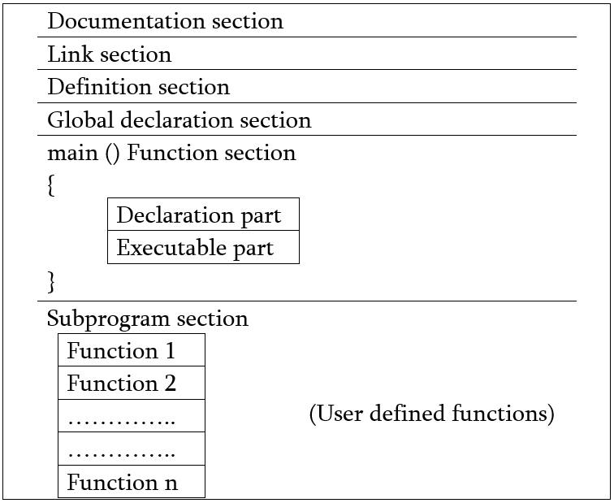
1-3 Basic Structure of ‘C’ Program
Structure of C Program
Chapter – 4 : Introduction to ‘C’ Language

Slide 9
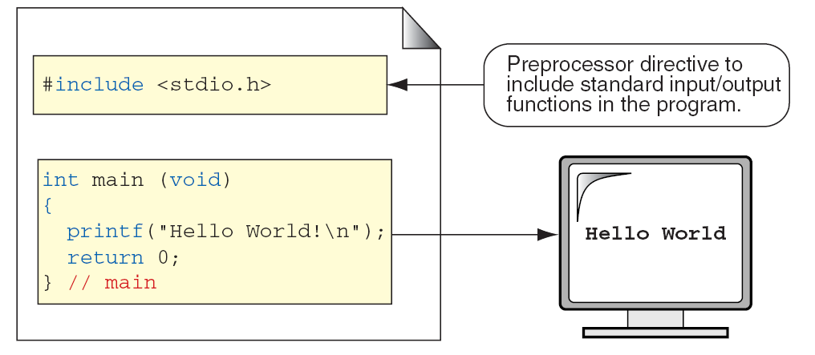
1-3 Basic Structure of ‘C’ Program
Structure of C Program
Chapter – 4 : Introduction to ‘C’ Language

Slide 10
1-3 Basic Structure of ‘C’ Program Continued..
Pre-Processor Directive :
Pre-Processor Directives tells the compiler to include Input/Output information for your program.
Preprocessor directives start with #
#include copies a file into the source code
#include <systemFilename>
Eg.
#include<stdio.h> // Standard Input/Output
#include<math.h> //Advanced Math Function(eg.Trignometry)
#include<conio.h> // Console Input / Output
#include<stdlib.h> // Arithmetic and Sorting & Searching
Chapter – 4 : Introduction to ‘C’ Language

Slide 11
The #define directive
It is a preprocessor compiler directive and not a statement., and therefore it should not end with a semicolon
Symbolic constants are generally written in uppercase so that they are distinguished from lowercase variable names.
Placed generally before the main() function.
Eg. #define PI 3.14
Chapter – 4 : Introduction to ‘C’ Language

Slide 12
1-3 Basic Structure of ‘C’ Program Continued..
Global Declaration
A global variable is a variable that is declared outside all functions.
A global variable can be used in all functions.
Eg. #include<stdio.h>
int a;
int b;
int main()
{
int Sum;
Sum=add();
printf(“Answer : %d”,Sum);
return 0;
}
int add ()
{
return a+b;
}
//Global Declaration
// As Declared Global can used in all function
Chapter – 4 : Introduction to ‘C’ Language

Slide 13
1-3 Basic Structure of ‘C’ Program Continued..
The main() function :
Programs must have a main() function.
Allowed Format :
main()
main(void)
int main()
int main(void)
void main()
void main(void)
Chapter – 4 : Introduction to ‘C’ Language

Slide 14
1-3 Basic Structure of ‘C’ Program Continued..
Local Definition :
A local variable can only be used in the function where it is declared.
Eg.
int main()
{
int a,b,c; // Local Declaration
printf(“Hello”);
return 0;
}
int add()
{
return a+b; // Cannot accessible outside main() function as declared as Local
}
Chapter – 4 : Introduction to ‘C’ Language

Slide 15
1-3 Basic Structure of ‘C’ Program Continued..
printf() function :
It is used to print standard output (Screen).
It can take variable number of argument.
The first argument must be a String.
Eg.
printf(“Message”, Variable or Variable List);
printf(“Hello”);
Printf(“Answer : %d”,Sum);
Chapter – 4 : Introduction to ‘C’ Language

Slide 16
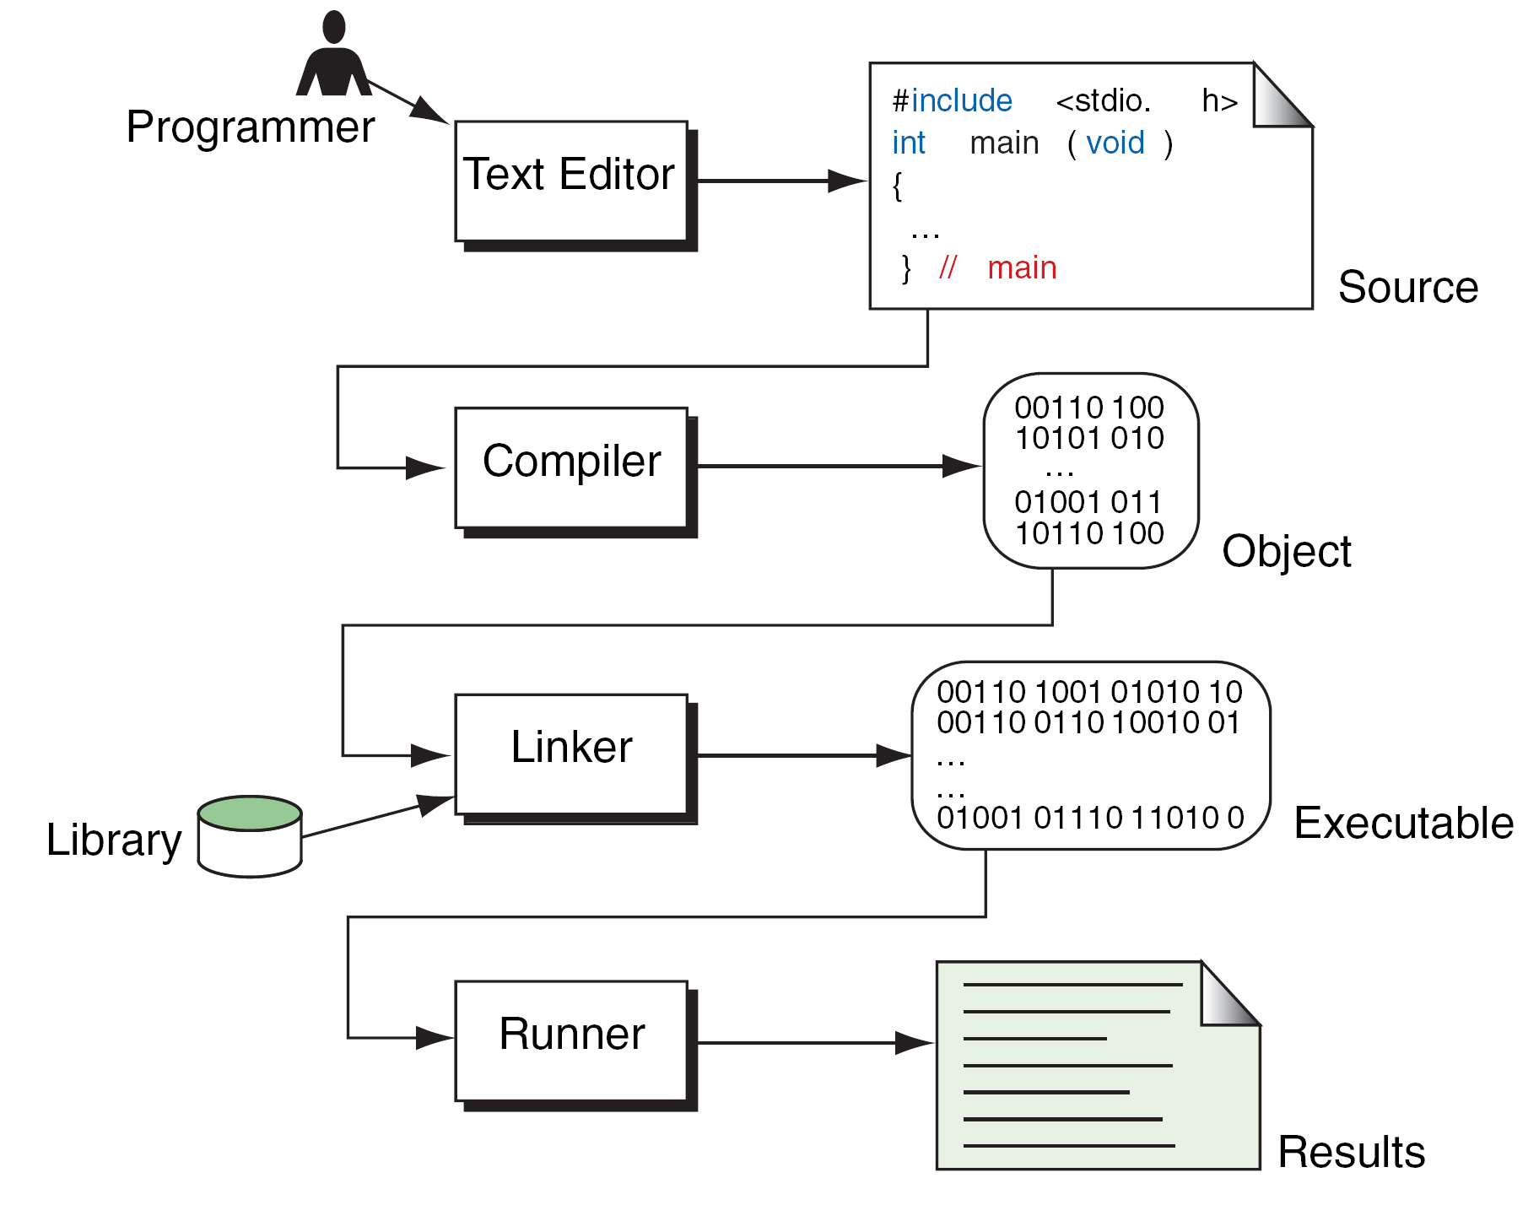
1-4 Compilation of C Program
Chapter – 4 : Introduction to ‘C’ Language

Slide 17
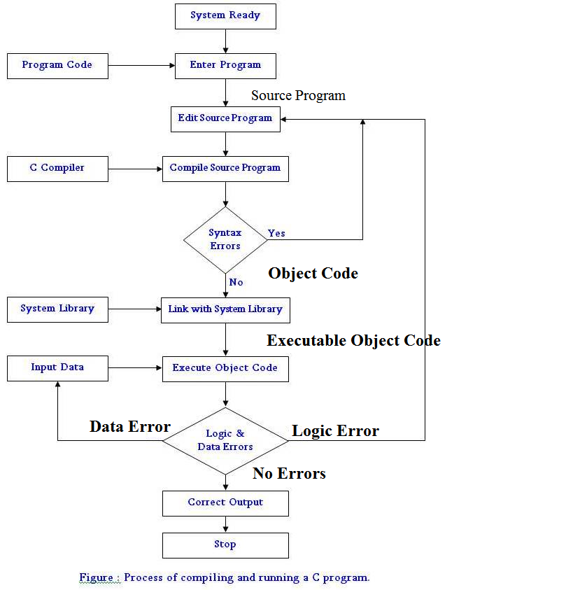

Chapter – 4 : Introduction to ‘C’ Language

Slide 18
1-4 Compilation of C Program Continued…
Pre-Processor
The main function of the C preprocessor is to remove comments from the source code and interpret preprocessor directives which are given by the statements that begin with #.
The #include statement can either be called with
#include<file.h>
or with
#include ‘‘file.h’’
The first method tells the preprocessor to look for the file in the standard include directories.
The second method, which uses the quotes, tells the preprocessor that the file to be included is in the local directory.
Chapter – 4 : Introduction to ‘C’ Language

Slide 19
1-4 Compilation of C Program Continued…
Compiler
The compiler translates the C code into assembly language, which is a machine level code that contains instructions.
Converted assembly language code having extension “.s”.
Assembler
Assembler translates the assembly language code into machine language.
Converted code having extension “.o” (Object file)
Chapter – 4 : Introduction to ‘C’ Language

Slide 20
1-4 Compilation of C Program Continued…
Linker
The object file hello.o contains a binary version of the machine language that was created from your source code hello.c. In order to create the executable hello or a.out, you need to use the linker to process your main function.
In example, we used the printf function. The printf function is a standard function that is provided by the C compiler that your current object file knows nothing about.
In order to use this function, we need to use the linker in order to link our program with the precompiled libraries provided to us by the C compiler. The linker links other precompiled object files or libraries together and creates the executable hello.
Chapter – 4 : Introduction to ‘C’ Language

Slide 21
Questions from previous year papers
What is the significance of Compiler?
(2 Marks)
Which are the Pre-processer directive? (2 Marks)
Define any two chracteristics of C Language with example. (3 Marks)
What is the purpose of Linker?(2 Marks)
Chapter – 4 : Introduction to ‘C’ Language

Slide 22
Questions from previous year papers
Fill in the blanks
C was developed by _________
_______ is a group of C statements that are executed together.
Execution of the C program begins at ________.
In memory, characters are stored as _________.
The statement return 0; returns 0 to the __________.
A C program ends with a ____________.
Chapter – 4 : Introduction to ‘C’ Language

Slide 23
Questions from previous year papers
State True or False
We can have only one function in a C program.
Header files are used to store the program’s source code.
Stdio.h is used to store the source code of the program.
The closing brace of the main() is the logical end of the program.
The declaration section gives instruction to the computer.
Declaration of the variables can be done anywhere in the program.
Chapter – 4 : Introduction to ‘C’ Language

Slide 24
Questions from previous year papers
Review Questions
Explain the difference between declaration and definition.
Give the structure of C program.
Why do we include <stdio.h> in our programs?
Explain the utility of #define and #include statements.
Draw and explain the process of compiling and running a C program.
Write the various forms of main that are allowed.
Draw a flowchart describing the history of C.
Explain the importance of C (in points).
Chapter – 4 : Introduction to ‘C’ Language

Slide 25

Chapter – 3 : Introduction to Programming

